Slide 1

Sorting Algorithms
Kenneth Stearns

Slide 2

What is a sorting algorithm?
Type of Algorithm
Puts stuff in numerical order
Options for all number-based types

Slide 3

Why use sorting?
Turn “dirty” information into clean
Organize information
Speed up future calls

Slide 4

Testing procedures
Create text file with numbers
Create program with sorting options
Include integer for number of operations
Include system time for durations
Use program to test sorting options

Slide 5
Sorting methods tested
Insertion
Bubble
Merge
Heap
Radix
Selection
Tim
Pigeonhole
Bitronic
Comb

Slide 6

Deeper dive
Merge Sort
Insertion Sort
Bubble Sort

Slide 7

Merge sort
Breaks array into smaller arrays
Compares two values
Combines smaller arrays back to original
Time Complexity: Worst Case O(n log n)
Space Complexity: O(n)

Slide 8
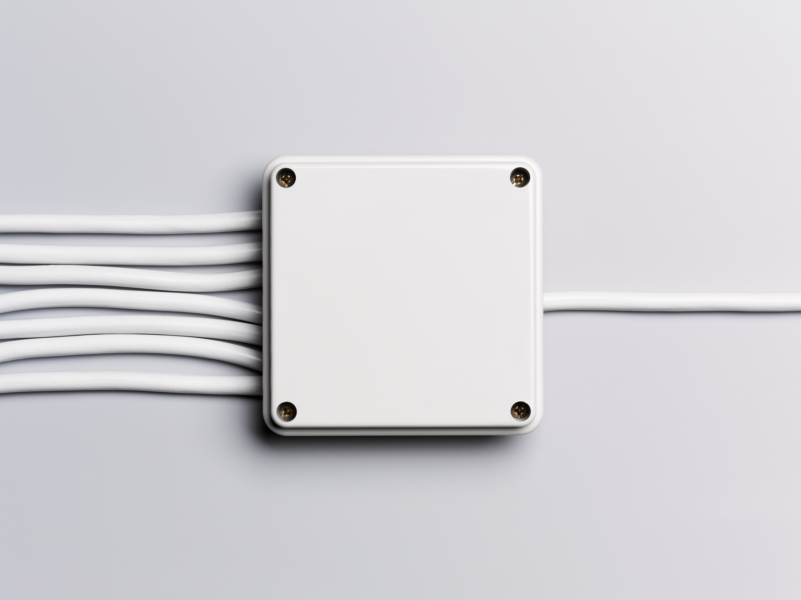
Merge sort cont
Results:
# of operations 133,616
Average time 1603 microseconds

Slide 9

Insertion sort
Keeps everything in same array
Compares two adjacent elements
Compares with element before
Time Complexity: Worst Case O(n^2)
Space Complexity: O(1)

Slide 10

Insertion sort cont
Results:
# of operations 25,335,879
Average time 40,522 microseconds

Slide 11

Bubble sort
Similar to insertion sort
Compares two adjacent elements
Compares with element after
Time Complexity: Worst case O(n^2)
Space Complexity: O(1)

Slide 12

Bubble sort cont
Results:
# of Operations: 99,950,004
Average time 222,579 microseconds

Slide 13
Results
Sorting Method | # of Operations | Average Time (microseconds)
Insertion | 25,325,880 | 40,522
Bubble | 99,950,004 | 222,579
Merge | 133,616 | 1,603
Heap | 290,241 | 1,527
Radix | 160,049 | 1,255
Selection | 50,004,999 | 61,409
Tim | 260,043 | 601
Pigeonhole | 62,762 | 2,524
Bitronic | 539,982 | 3,488
Comb | 316,770 | 1,202

Slide 14

Next steps
More varied test environments
More sorting algorithms

Slide 15

Concluding thoughts
No one right answer
Environment and Resource based

Slide 16

Questions?
Ken Stearns
(123) 456-7890
tr8261dl@go.stcloudstate.edu

